Slide 1


SUDDEN FALL
Team JCCS
The aim for this project is to create a wearable device that is able to detect a sudden fall. When a sudden fall has been detected the device will send out a distress message using our fall detection android application. The distress message will be sent to a recipient that is responsible for the user. It will include a text message to alert the recipient and a link of the exact location using google maps. There are two major components to our fall detection device. The first component is the headset which includes sensors that calculates real time data of the user’s acceleration and orientation in free space. It will stream data to the second component which is the android application.

Slide 2
DETECTION SYSTEM
The phone application adds a second layer of accuracy to the fall detection device by using the onboard sensors which will be used in conjunction with the data from the headset to make accurate decisions for whether or not a fall has occurred. The device therefore has two modes, one mode is called the standalone mode which is the headset making the decisions and the second mode called the Master-Slave mode is when both the headset and phone application are paired. The phone application has many features such as a pedometer to track the number of steps taken, a graph to see real time data, data logger, distance traveled, and a calorie counter. This concept of a fall detection device will serve to be an important line of defense to mitigate the death and injury rate that comes from sudden falls.

Slide 3
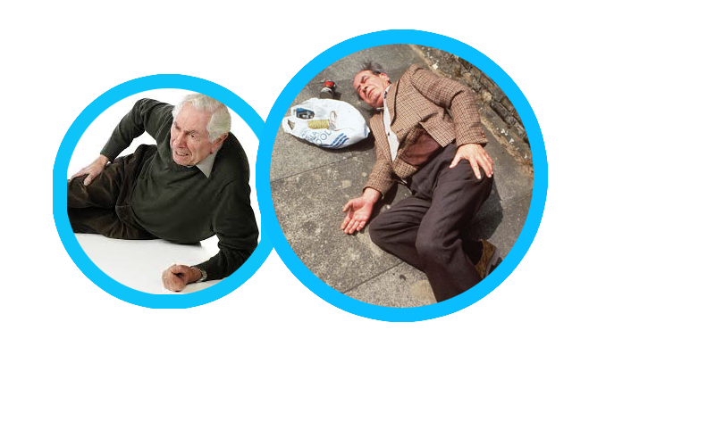
FACTS & MOTIVATION
Facts:
1 in 3 people over the age of 65 will encounter a sudden fall at least once a year
Falls are the leading causes to fatal and non-fatal injuries among the elderly population
In 2013, 25500 people died from an unintentional fall

Slide 4
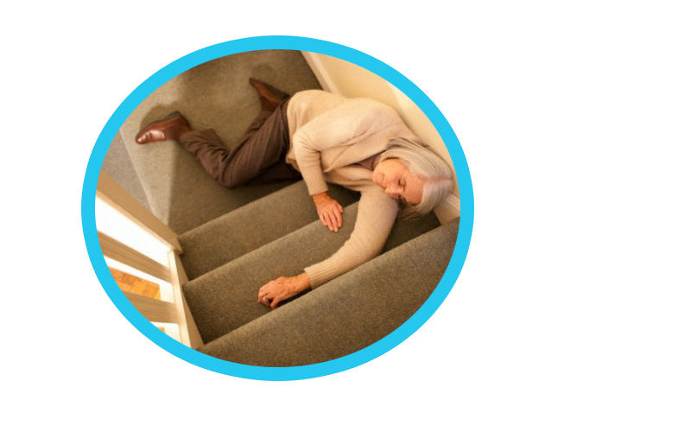
Motivation:
We were inspired by the Fitbit, and realized that wearable technology is a growing industry
To prevent the loss of life from unattended sudden falls
Our project aims to provide a path towards more independent living for the elderly.

Slide 5
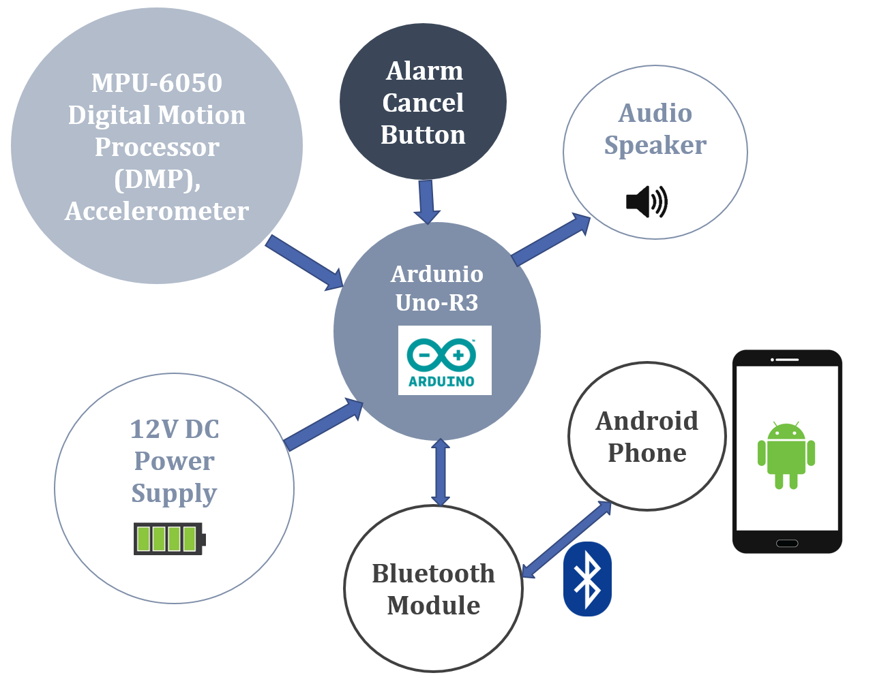
Conceptual Design Overview

Slide 6
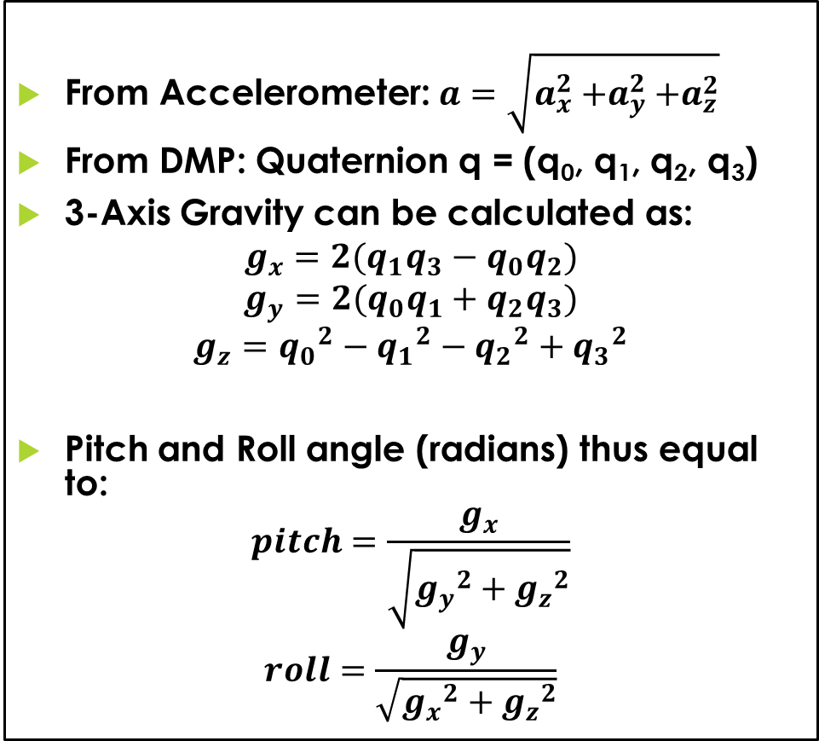
Algorithm
From Accelerometer: $a=\sqrt{a_{x}^{2}{+a}_{y}^{2}+a_{z}^{2}}$
From DMP: Quaternion q = (q₀, q₁, q₂, q₃)
3-Axis Gravity can be calculated as:
$$g_{x}=2(q_{1}q_{3}−q_{0}q_{2})$$
$$g_{y}=2(q_{0}q_{1}+q_{2}q_{3})$$
$$g_{z}={q_{0}}^{2}−{q_{1}}^{2}−{q_{2}}^{2}+{q_{3}}^{2}$$
Pitch and Roll angle (radians) thus equal to:
$$pitch=\frac{g_{x}}{\sqrt{{g_{y}}^{2}+{g_{z}}^{2}}}$$
$$roll=\frac{g_{y}}{\sqrt{{g_{x}}^{2}+{g_{z}}^{2}}}$$
Standalone Mode:
Sensor Acceleration Magnitude > Headset Threshold Magnitude
and
Sensor Pitch or Roll Angle > Headset Threshold Angle
Master-Slave Mode:
Phone Acceleration Magnitude > Phone Threshold Magnitude
Trigger a timeframe and wait for
Sensor Acceleration Magnitude > Headset Threshold Magnitude
and
Sensor Pitch or Roll Angle > Headset Threshold Angle
OR
Sensor Acceleration Magnitude > Headset Threshold Magnitude
and
Sensor Pitch or Roll Angle > Headset Threshold Angle
Trigger a timeframe and wait for
Phone Acceleration Magnitude > Phone Threshold Magnitude

Slide 7
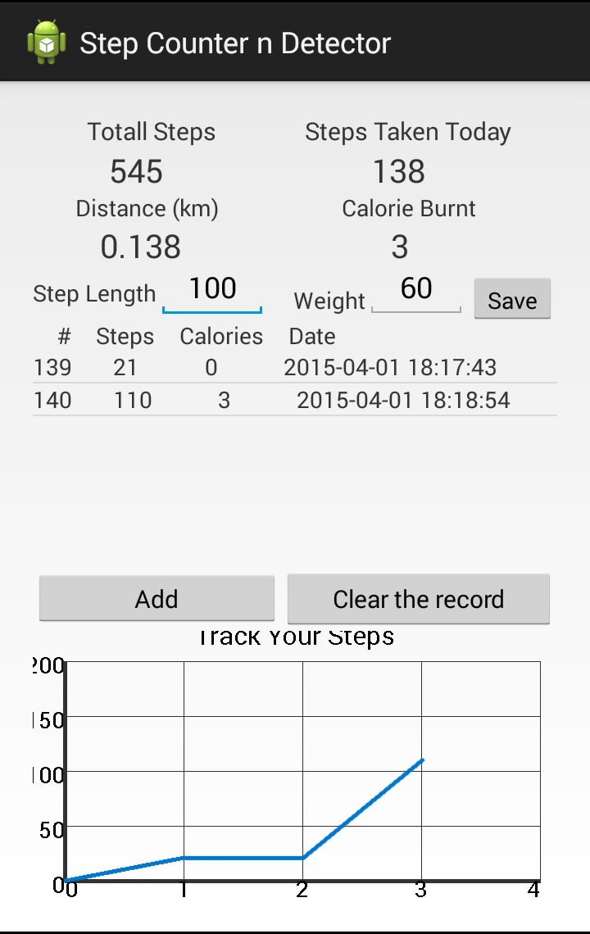
Pedometer Feature Based on add-on sensor in KIKAT 4.4 (API 19)
Step Counting
Daily Steps Counting
Total Steps
Distance Walked
Daily walking distance
Step length * steps walked
Distance*weight*exerciser level factor
Calorie Burnt
Save/Delete/Update Data
SQLite Database
User Preference
Shared Preference
Scheduled by Alarm Manager

Slide 8
Existing Technology
 | JCCS FD GEN 1 | Philips Lifeline | Mobile Help | Fall Detector (Android App)
Pros | Automatic detection of a fall Phone application helps aid in accuracy and user experience Health monitoring Cheap alterative to other fall detection devices The device is user configurable The device gives maximize flexibility to the user since the range of the device is Distress message will be sent with a GPS coordinate that is linked to google maps. | Discrete device that can be wore around the neck Push button to signal for help | Automatic detection of a fall Provides freedom to the user to go outside of their home since there is no base station needed | Automatically detect a sudden fall Free application
Cons | The user must have a smart phone to utilize most of this product features | It does not automatically detect falls The user must press the button to call for help Device has a range limitation | There is a subscription fee | Not accurate Utilizes only one point of measurements (waist)

Slide 9
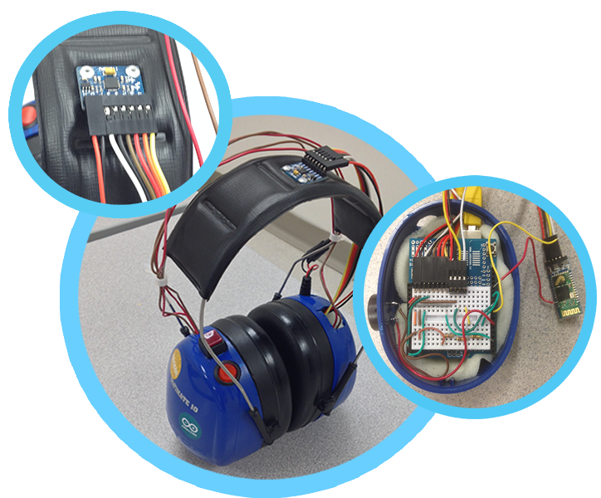
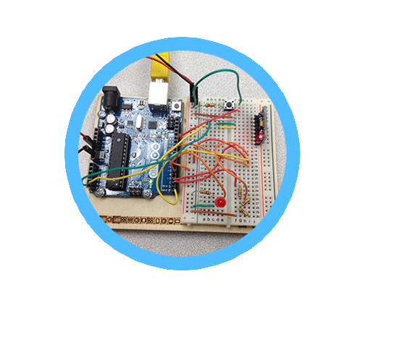
Hardware Implementation
MPU 6050
Bluetooth Shield
Initial Implementation
Arduino Uno Board

Slide 10
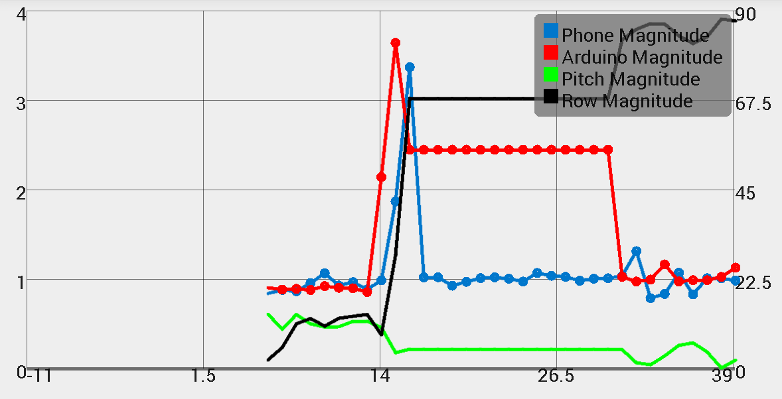
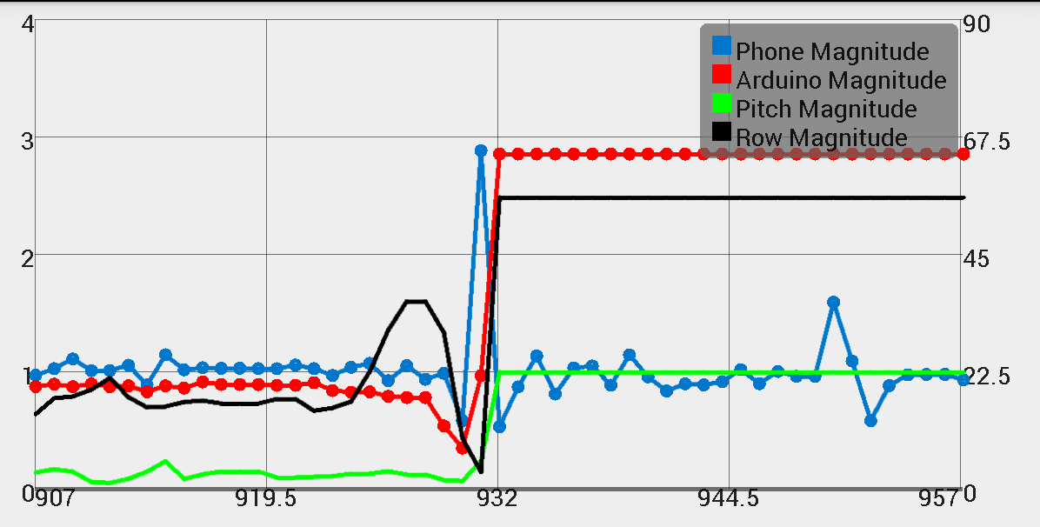
Fall Types
Face down Fall
Back Fall
In this case the headset makes contact first and then the phone
The headset and phone acceleration reach 3.6G and 3.4G respectively
Contact was made first from the waist then to the head
Both accelerations reach 2.9G

Slide 11
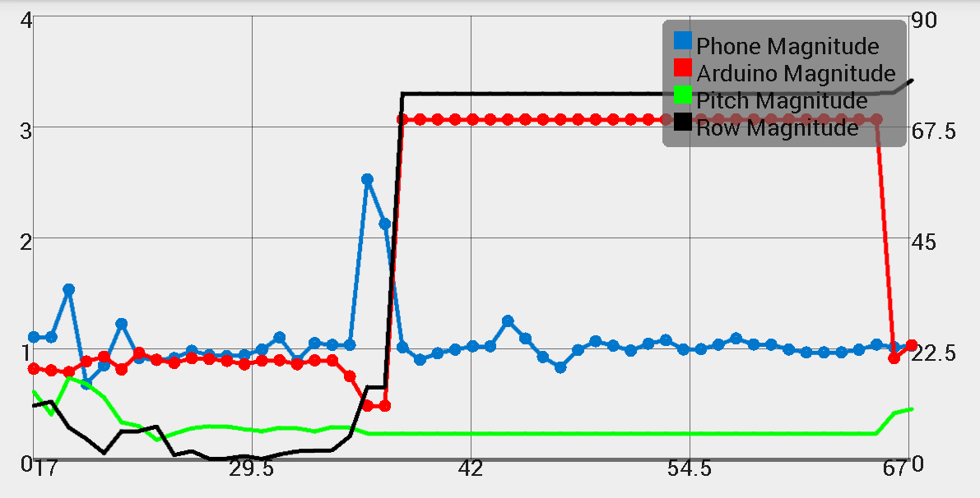
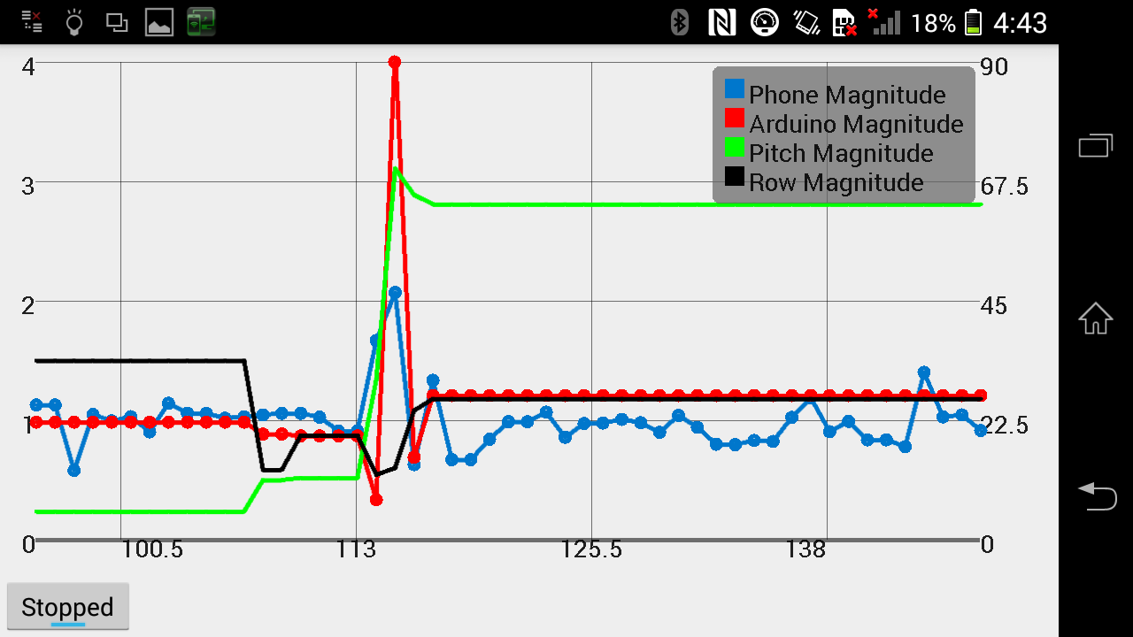
Missed a Chair Fall
Side Fall
Since in this event the user missed the chair, the first point of contact was made with the waist, then 0.6 seconds later the headset met its acceleration
The waist had an acceleration of 2.6G and the headset with 3.1G
In this event we can see that the pitch was not affected, but the roll angle changed since this was a side fall
The headset reach a magnitude of 4G and the waist of 2.1G

Slide 12
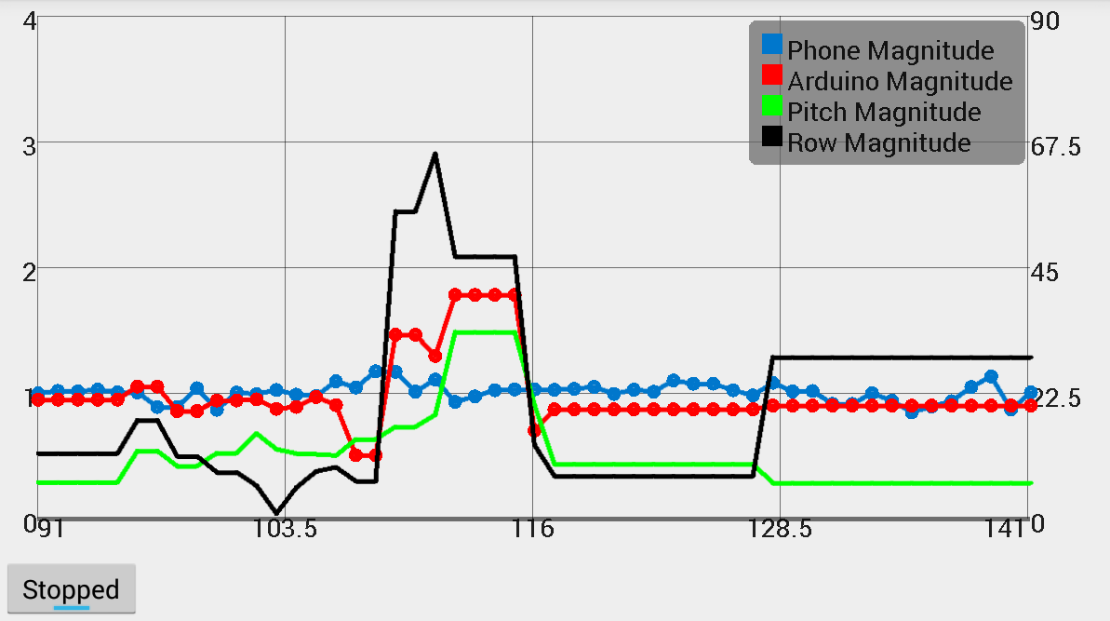
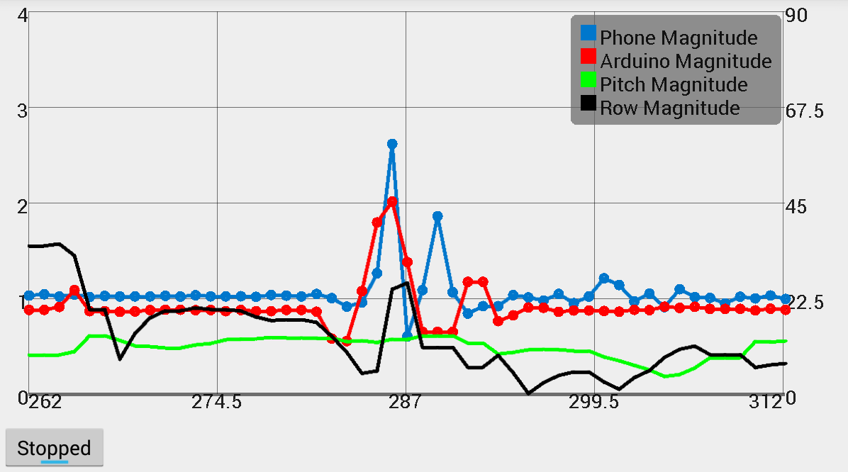
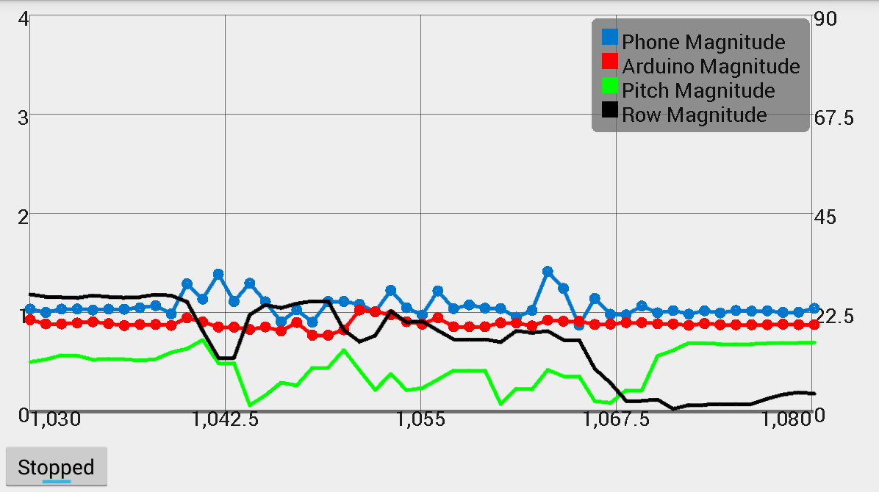
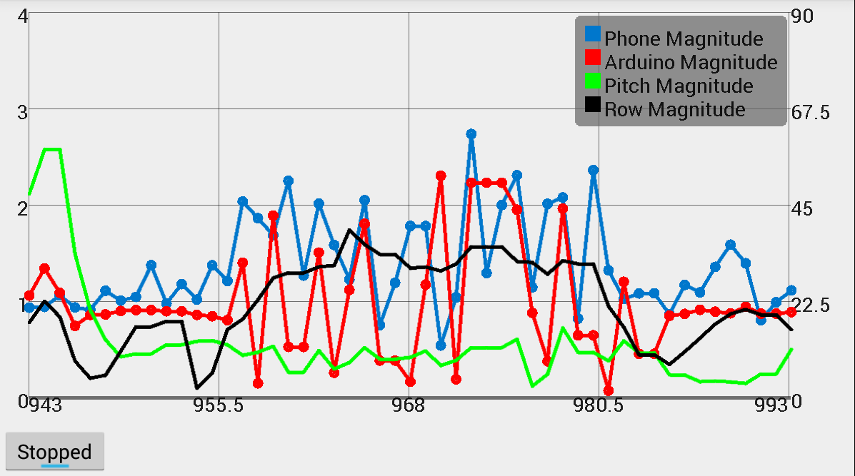
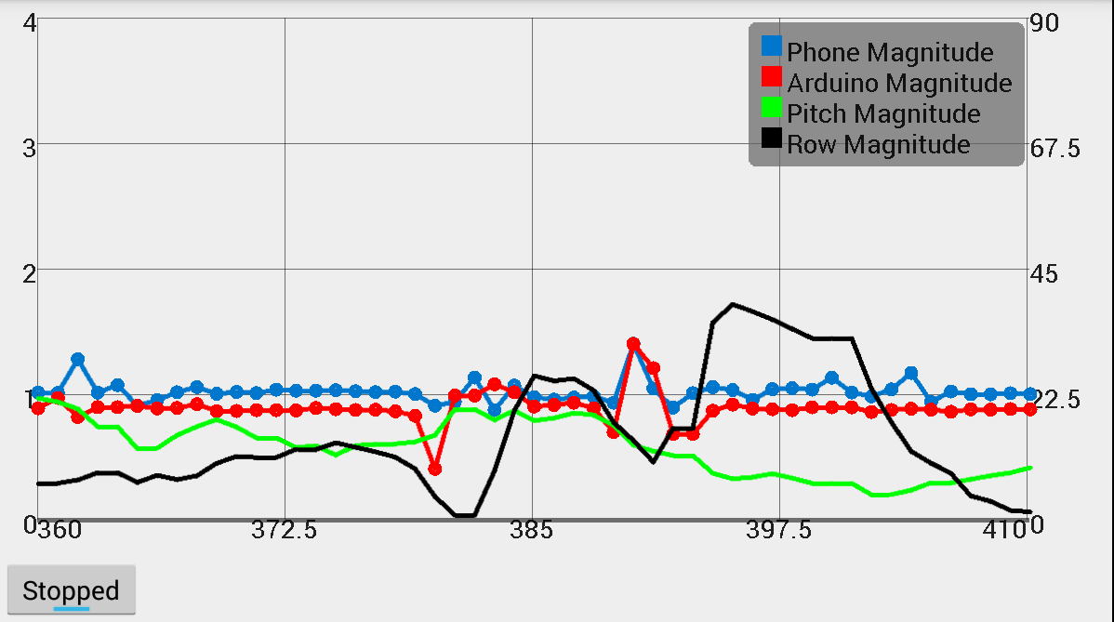
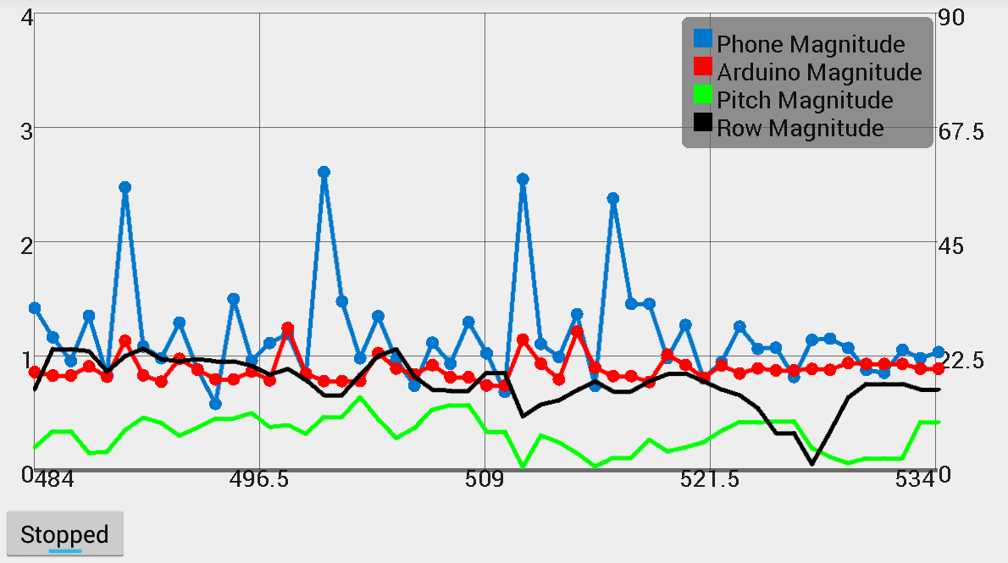
Regular Activities
Bend Down
Hop
Spinning
Jogging
Sitting
Walking

Slide 13
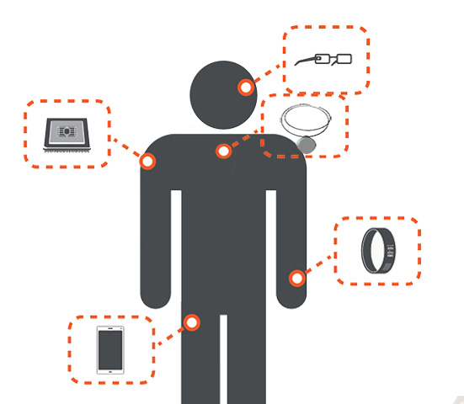
Future Direction
Commercializing this product will include making the device smaller and more efficient in terms of battery life.
A modular device that can be place into various wearable items to meet user’s needs (ex. necklace, bracelet, around the ear, etc.)
More data analysis on different body types such as weight and height to provide more accurate fall detection.

Slide 14
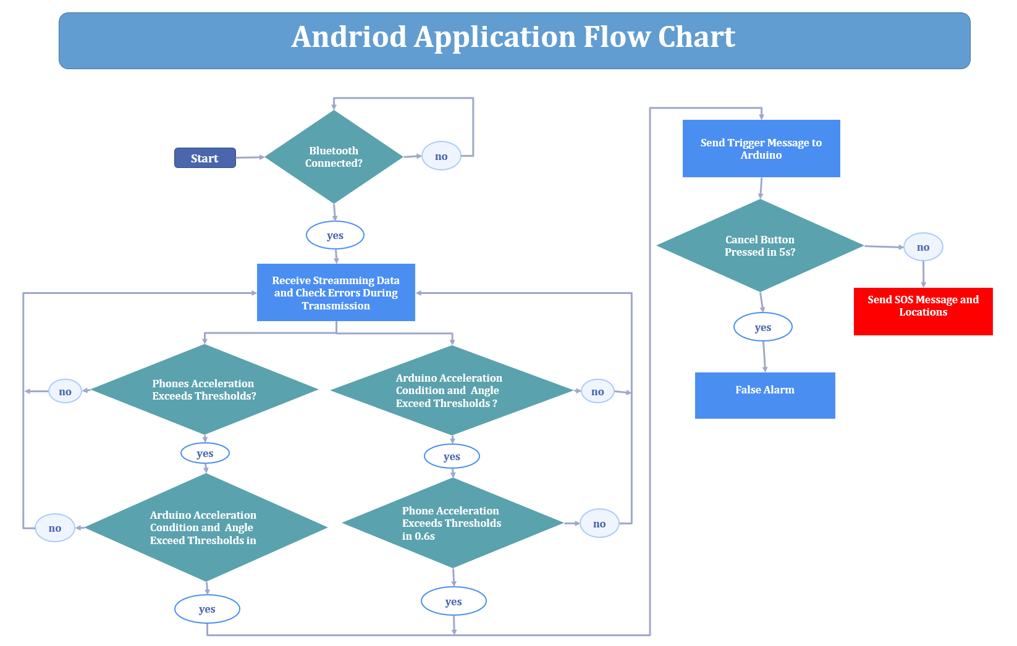

Slide 15
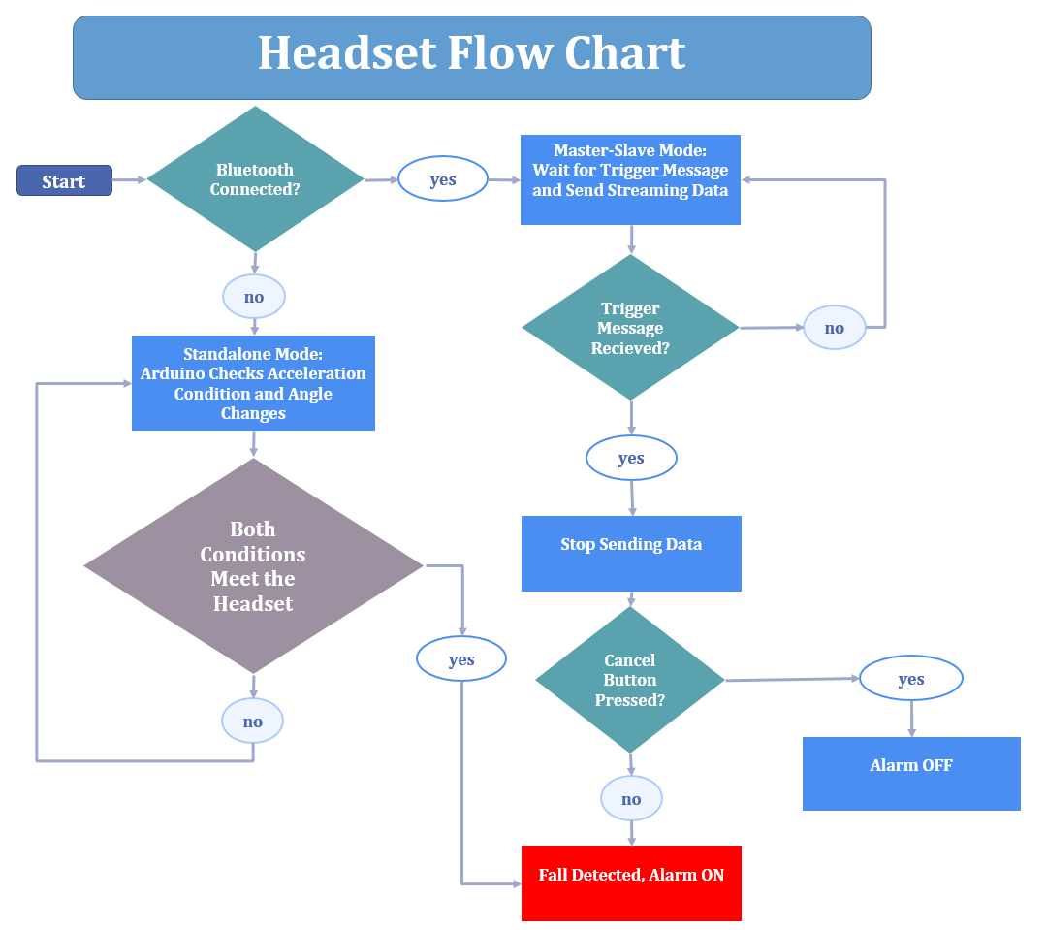

Slide 16
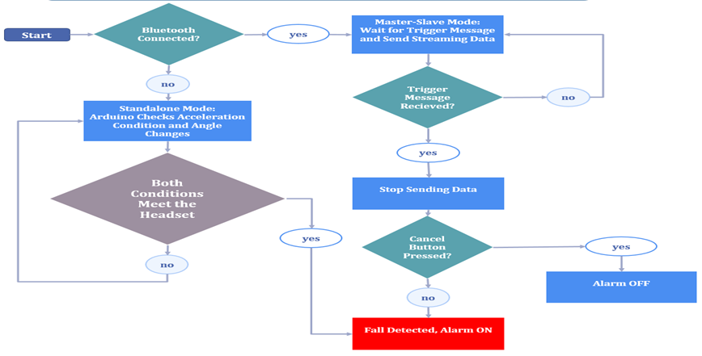
Headset Flow Chart

Slide 17
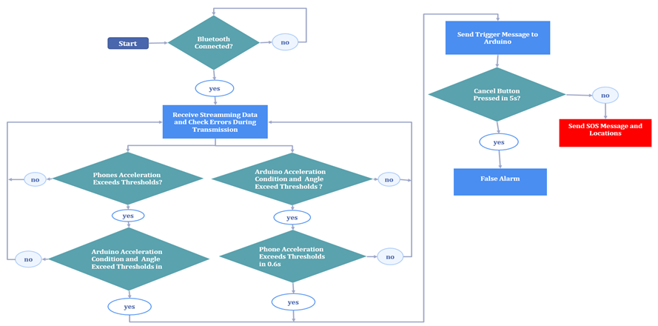
Android Application Flow Chart

